Slide 1

CMPT 413/713: Natural Language Processing
Sequence Models - HMMs
Zhiyun (Richard) Peng
2026-10-14
Adapted from slides from Angel Chang, Anoop Sarkar, Danqi Chen and Karthik Narasimhan
Notes:
http://demo.clab.cs.cmu.edu/NLP/

Slide 2
Overview
What is sequence modeling?
Hidden markov models (HMM)
Decoding algorithms: Greedy, Viterbi, Beam
Maximum entropy markov models (MEMM)

Slide 3
Sequence modelling
NLP is all about sequence modelling
  Sequence tagging
  Sequence generation
Different models for sequence modelling
  HMMs, RNNs, Transformers

Slide 4
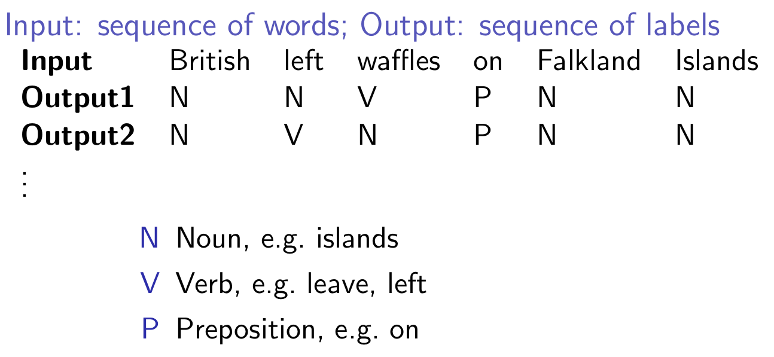
Sequence Tagging (part-of-speech)
A famous headline pun
Example from Anoop Sarkar
Notes:
part-of-speech 词性
主语是 British left（英国左翼 / 英国左派人士），谓语动词是 waffles（waffle 作动词表示“优柔寡断”、“胡扯吞吐”、“立场摇摆不定”），介词短语 on Falkland Islands（在福克兰群岛问题上）

Slide 5
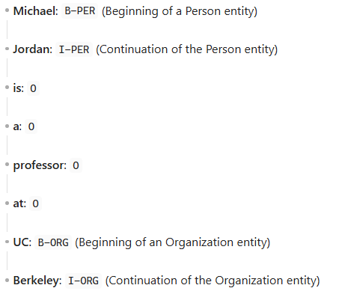
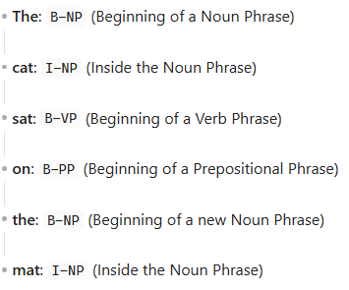
Other sequence tagging problems
BIO encoding
Begin, inside, outside
Named Entity Recognition
  Michael Jordan is a professor at UC Berkeley.
Shallow Phrase Chunking
  The cat sat on the mat under the sun
I-
I-
B-
PER
ORG
PER
B-
ORG
O
O
O
O
B-NP
I-NP
B-VP
B-PP
B-NP
I-NP
B-PP
B-NP
I-NP

Slide 6
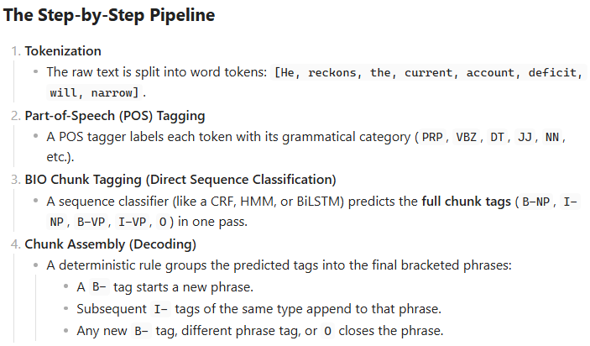
Sequence Tagging (phrase chunking)
[NP He ] [VP reckons ] [NP the current account deficit ] [VP will narrow ]
B-NP | B-VP | B-NP | I-NP | I-NP | I-NP | B-VP | I-VP
PRP | VBZ | DT | JJ | NN | NN | MD | VB
He | reckons | the | current | account | deficit | will | Narrow
Part-of-Speech (POS) Tagging
Example from https://www.cnts.ua.ac.be/conll2000/chunking/

Slide 7
Part of speech tags

Slide 8
What are POS tags?
Word classes or syntactic categories
  Reveal useful information about a word (and its neighbors!)
Singular noun
Determiner
Verb, past tense
The/DT cat/NN sat/VBD on/IN the/DT mat/NN
British/NNP left/NN waffles/NNS on/IN Falkland/NNP Islands/NNP
The/DT old/NN man/VB the/DT boat/NN

Slide 9
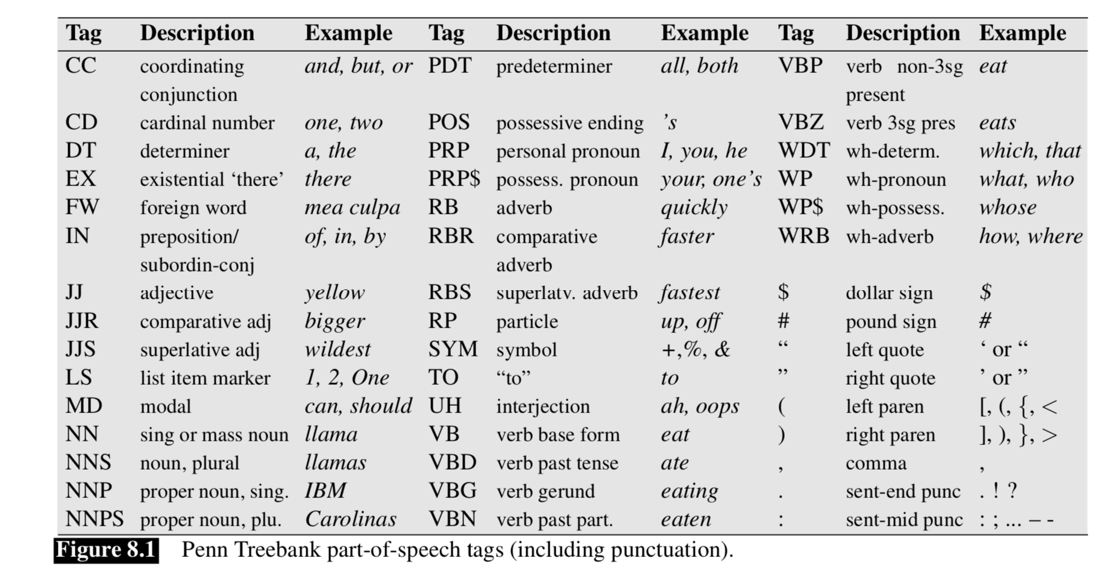



Penn Tree Bank tagset
[45 tags]
(Marcus et al., 1993)
Other corpora: Brown, WSJ, Switchboard

Slide 10
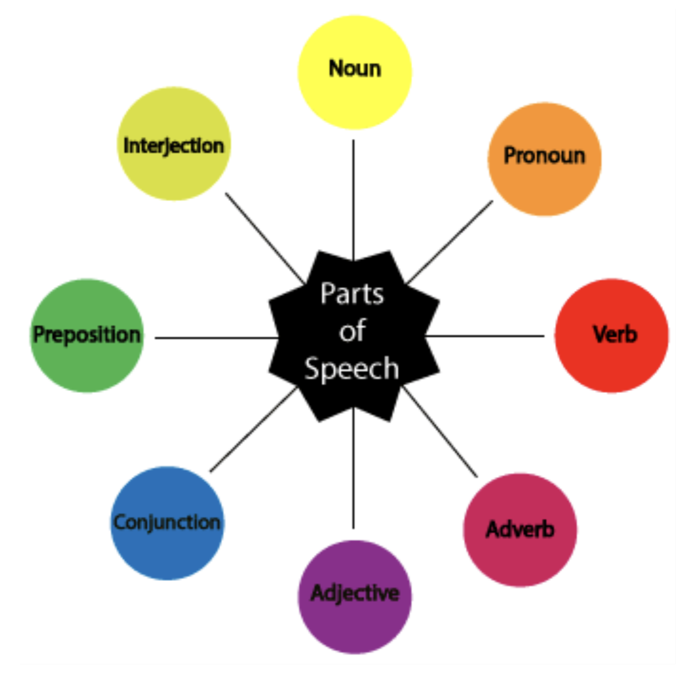
Parts of Speech
Different words have different functions
Closed class: fixed membership, function words
  e.g. prepositions (in, on, of), determiners (the, a)
Open class: New words get added frequently
  e.g. nouns (Twitter, Facebook), verbs (google), adjectives, adverbs

Slide 11
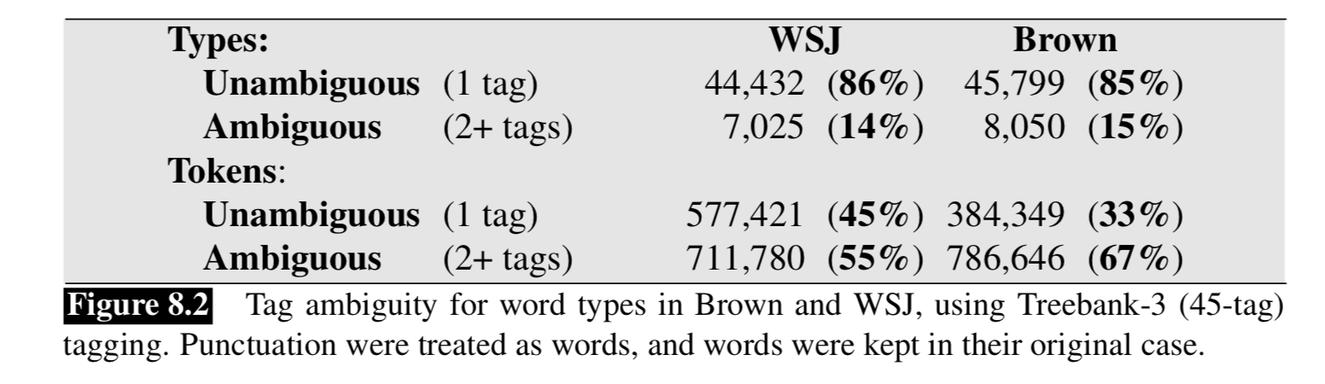

Part of Speech Tagging
Disambiguation task: each word might have different senses/functions
  The/DT man/NN bought/VBD a/DT boat/NN
  The/DT old/NN man/VB the/DT boat/NN
To operate
a Set (size = unique vocabulary size)
a List (length = total word count)
More ambiguous

Slide 12
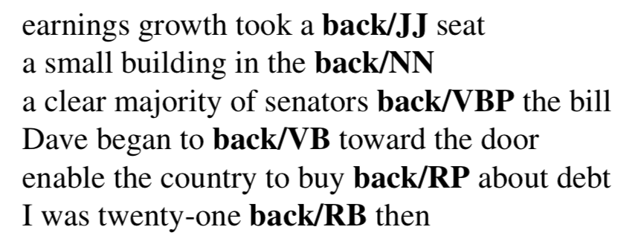
Part of Speech Tagging
Disambiguation task: each word might have different senses/functions
  The/DT man/NN bought/VBD a/DT boat/NN
  The/DT old/NN man/VB the/DT boat/NN
Some words have many functions!

Slide 13
A simple baseline
Many words might be easy to disambiguate
Most frequent class: Assign each token (word) to the class it occurred most in the training set. (e.g. man/NN)
  Accurately tags 92.34% of word tokens on Wall Street Journal (WSJ)!
Word error rate (WER) compounds:
  Consider model with ~97-98% accuracy
  Average English sentence ~ 14 words
    Sentence level accuracies: 0.92¹⁴ = 31% vs 0.97¹⁴ = 65% vs 0.98¹⁴ = 75%
  The/DT old/JJ man/NN the/DT boat/NN
Notes:
Compounds 复利累积效应

Slide 14
Hidden Markov Models

Slide 15
Some observations
The function (or POS) of a word depends on its context
  The/DT old/NN man/VB the/DT boat/NN
  The/DT old/JJ man/NN bought/VBD the/DT boat/NN
Certain POS combinations are extremely unlikely
  <JJ (adjective), DT> or <DT, IN (preposition)>
Better to make decisions on entire sequences instead of individual words (Sequence modeling!)

Slide 16

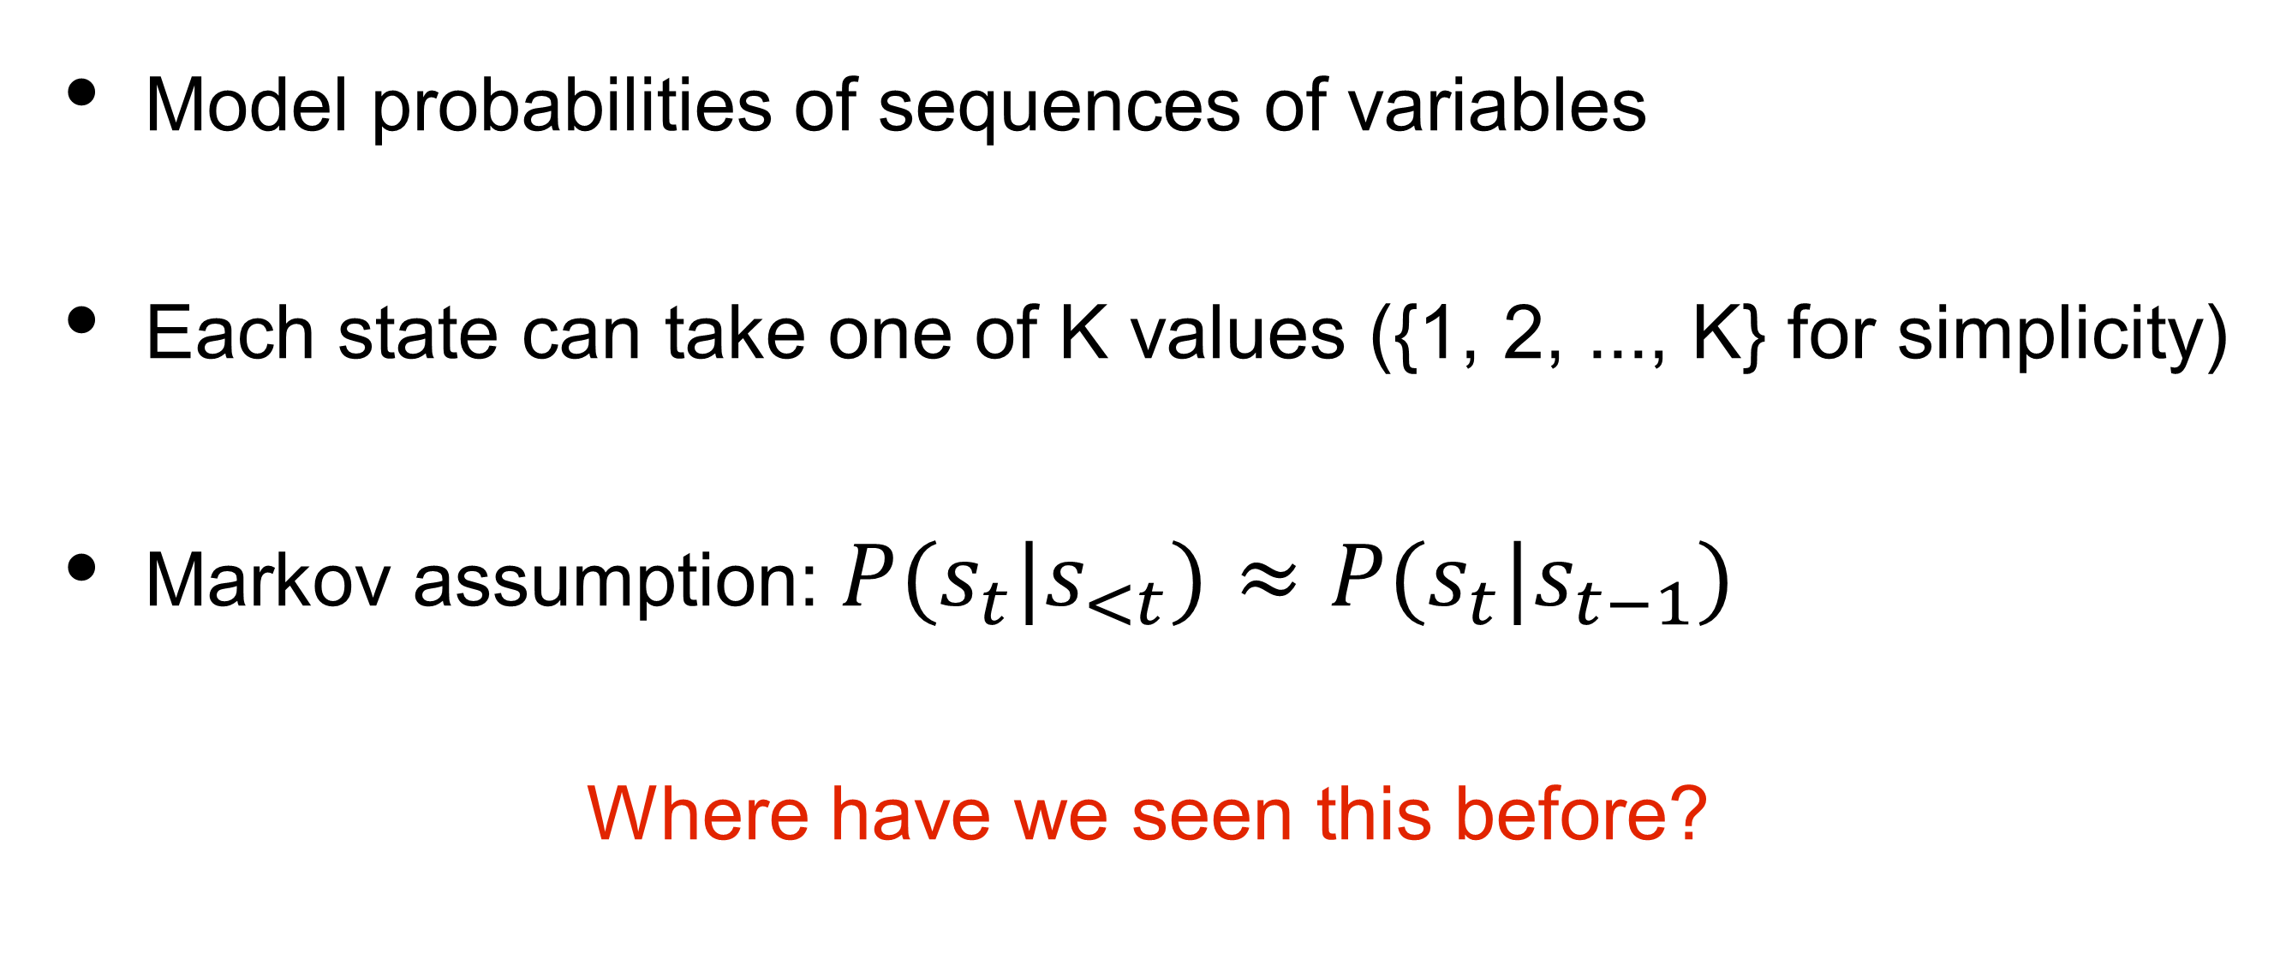
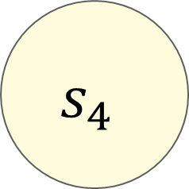
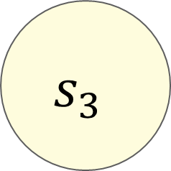


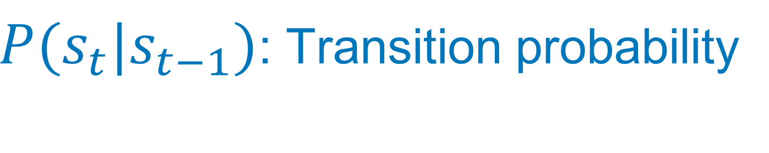
Markov chains
$π(s_{1})$: Initial distribution
$$s_{1}$$
$$s_{2}$$
$$s_{3}$$
$$s_{4}$$
State 1
$P(s_{t}|s_{t−1})$: Transition probability
Model probabilities of sequences of variables
Each state can take one of K values ({1, 2, ..., K} for simplicity)
Markov assumption: $P(s_{t}|s_{<t})≈P(s_{t}|s_{t−1})$
Where have we seen this before?
Notes:
Markov chains are used to model sequences of states.

Slide 17

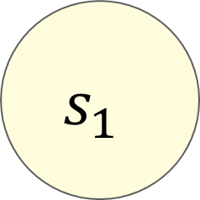


Markov chains
$$s_{1}$$
$$s_{2}$$
$$s_{3}$$
$$s_{4}$$
The/DT cat/NN sat/VBD on/IN the/DT mat/NN

Slide 18
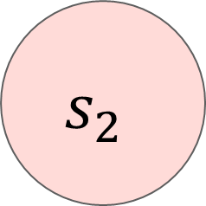
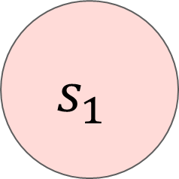
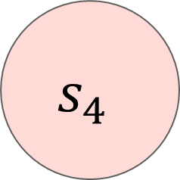

Markov chains
$$s_{1}$$
$$s_{2}$$
$$s_{3}$$
$$s_{4}$$
hidden
Tags
The/?? cat/?? sat/?? on/?? the/?? mat/??
  We don’t observe POS tags at test time

Slide 19
Hidden Markov Model (HMM)
$$s_{1}$$
$$s_{2}$$
$$s_{3}$$
$$s_{4}$$
hidden
Tags
the
cat
sat
on
Words
observed
The/?? cat/?? sat/?? on/?? the/?? mat/??
  We don’t observe POS tags at test time
  But we do observe the words!
  HMM allows us to jointly reason over both hidden and observed events.

Slide 20



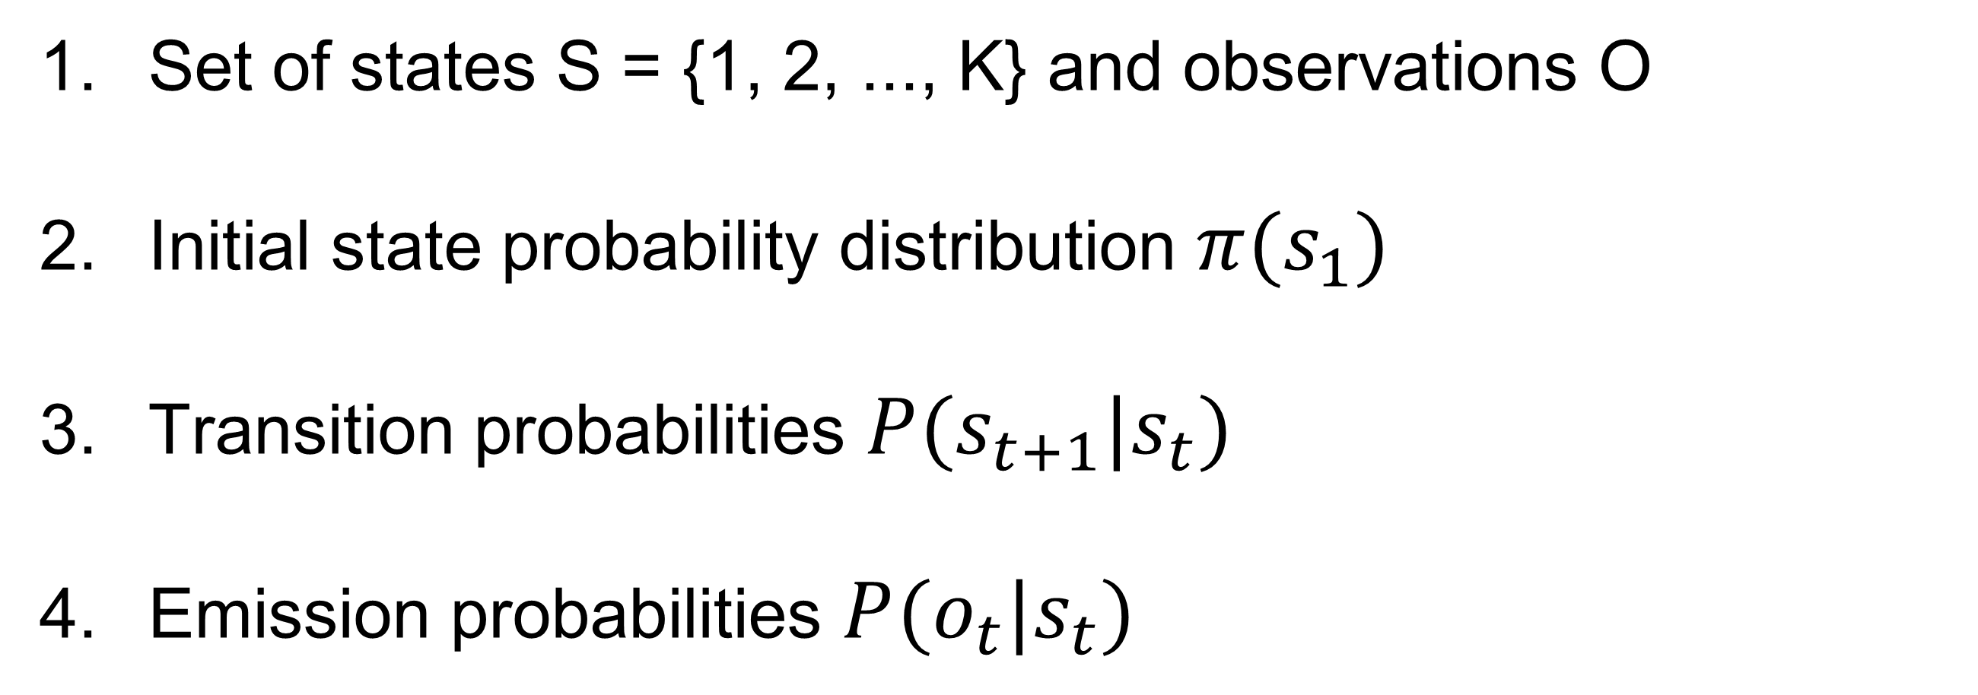
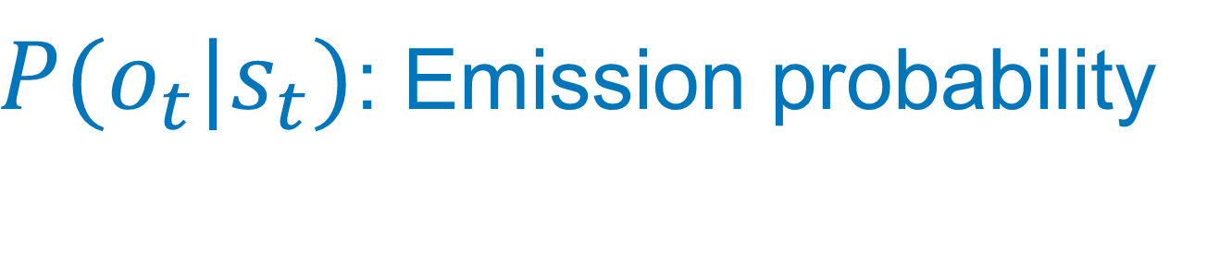

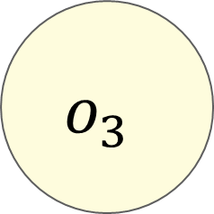
Components of an HMM
$$s_{1}$$
$$s_{2}$$
$$s_{3}$$
$$s_{4}$$
Tags
$$o_{1}$$
$$o_{2}$$
$$o_{3}$$
$$o_{4}$$
$P(o_{t}|s_{t})$: Emission probability
Words
Set of states S = {1, 2, ..., K} and observations O
Initial state probability distribution $π(s_{1})$
Transition probabilities $P(s_{t+1}|s_{t})$
Emission probabilities $P(o_{t}|s_{t})$

Slide 21
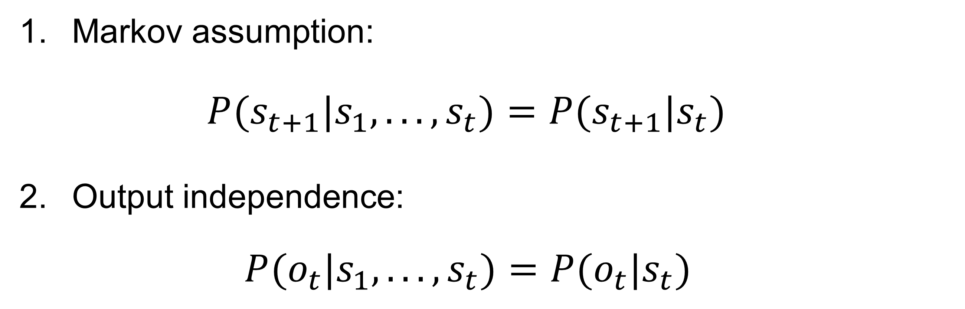
Assumptions
$$s_{1}$$
$$s_{2}$$
$$s_{3}$$
$$s_{4}$$
Tags
$$o_{1}$$
$$o_{2}$$
$$o_{3}$$
$$o_{4}$$
Words
Markov assumption:
    $P(s_{t+1}|s_{1},...,s_{t})=P(s_{t+1}|s_{t})$
Output independence:
  $P(o_{t}|s_{1},...,s_{t})=P(o_{t}|s_{t})$
Transition
Probabilities
Emission
Probabilities

Slide 22
What we want to be able to do?
$$s_{1}$$
$$s_{2}$$
$$s_{3}$$
$$s_{4}$$
Tags
$$o_{1}$$
$$o_{2}$$
$$o_{3}$$
$$o_{4}$$
Words
  Compute the probability (likelihood) of a sequence
  Estimate the model parameters (train the model)
  Use the model to generate new sequences (decoding)

Slide 23
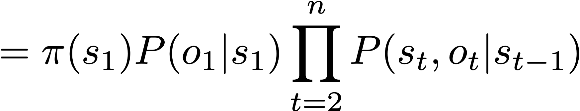
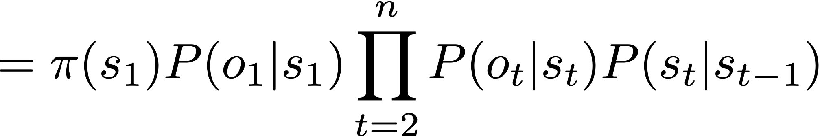


Sequence likelihood
$$s_{1}$$
$$s_{2}$$
$$s_{3}$$
$$s_{4}$$
Tags
$$o_{1}$$
$$o_{2}$$
$$o_{3}$$
$$o_{4}$$
Words

Slide 24
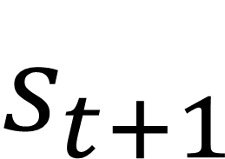
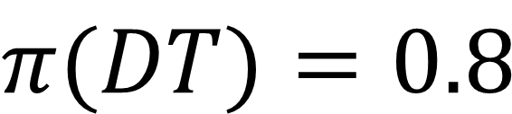
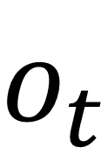
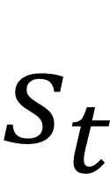
Example: POS tagging
the/DT cat/NN sat/VBD on/IN the/DT mat/NN
$$π(DT)=0.8$$
$$s_{t+1}$$
(preposition)
$$o_{t}$$
 | DT | NN | IN | VBD
DT | 0.05 | 0.8 | 0.05 | 0.1
NN | 0.05 | 0.2 | 0.15 | 0.6
IN | 0.5 | 0.2 | 0.05 | 0.25
VBD | 0.3 | 0.3 | 0.3 | 0.1
 | the | cat | sat | on | mat
DT | 0.5 | 0 | 0 | 0 | 0
NN | 0.01 | 0.2 | 0.01 | 0.01 | 0.2
IN | 0 | 0 | 0 | 0.4 | 0
VBD | 0 | 0.01 | 0.1 | 0.01 | 0.01
$$s_{t}$$
…
P(the|DT, cat|NN, sat|VBD, on|IN, the|DT, mat|NN) = ??
Notes:
DT DT

Slide 25
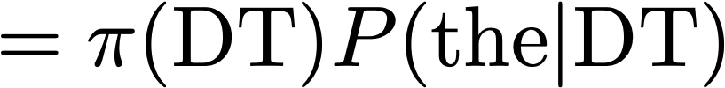







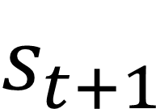
Example: POS tagging
the/DT cat/NN sat/VBD on/IN the/DT mat/NN
$$π(DT)=0.8$$
$$s_{t+1}$$
$$o_{t}$$
 | DT | NN | IN | VBD
DT | 0.05 | 0.8 | 0.05 | 0.1
NN | 0.05 | 0.2 | 0.15 | 0.6
IN | 0.5 | 0.2 | 0.05 | 0.25
VBD | 0.3 | 0.3 | 0.3 | 0.1
 | the | cat | sat | on | mat
DT | 0.5 | 0 | 0 | 0 | 0
NN | 0.01 | 0.2 | 0.01 | 0.01 | 0.2
IN | 0 | 0 | 0 | 0.4 | 0
VBD | 0 | 0.01 | 0.1 | 0.01 | 0.01
Where did these numbers come from?
$$s_{t}$$
Learned from data!
P(the|DT, cat|NN, sat|VBD, on|IN, the|DT, mat|NN) =
0.8
0.5
0.8
0.2
0.6
0.1
…
$$=1.84∗{10}^{−5}$$
Notes:
DT DT

Slide 26
Learning for HMMs

Slide 27
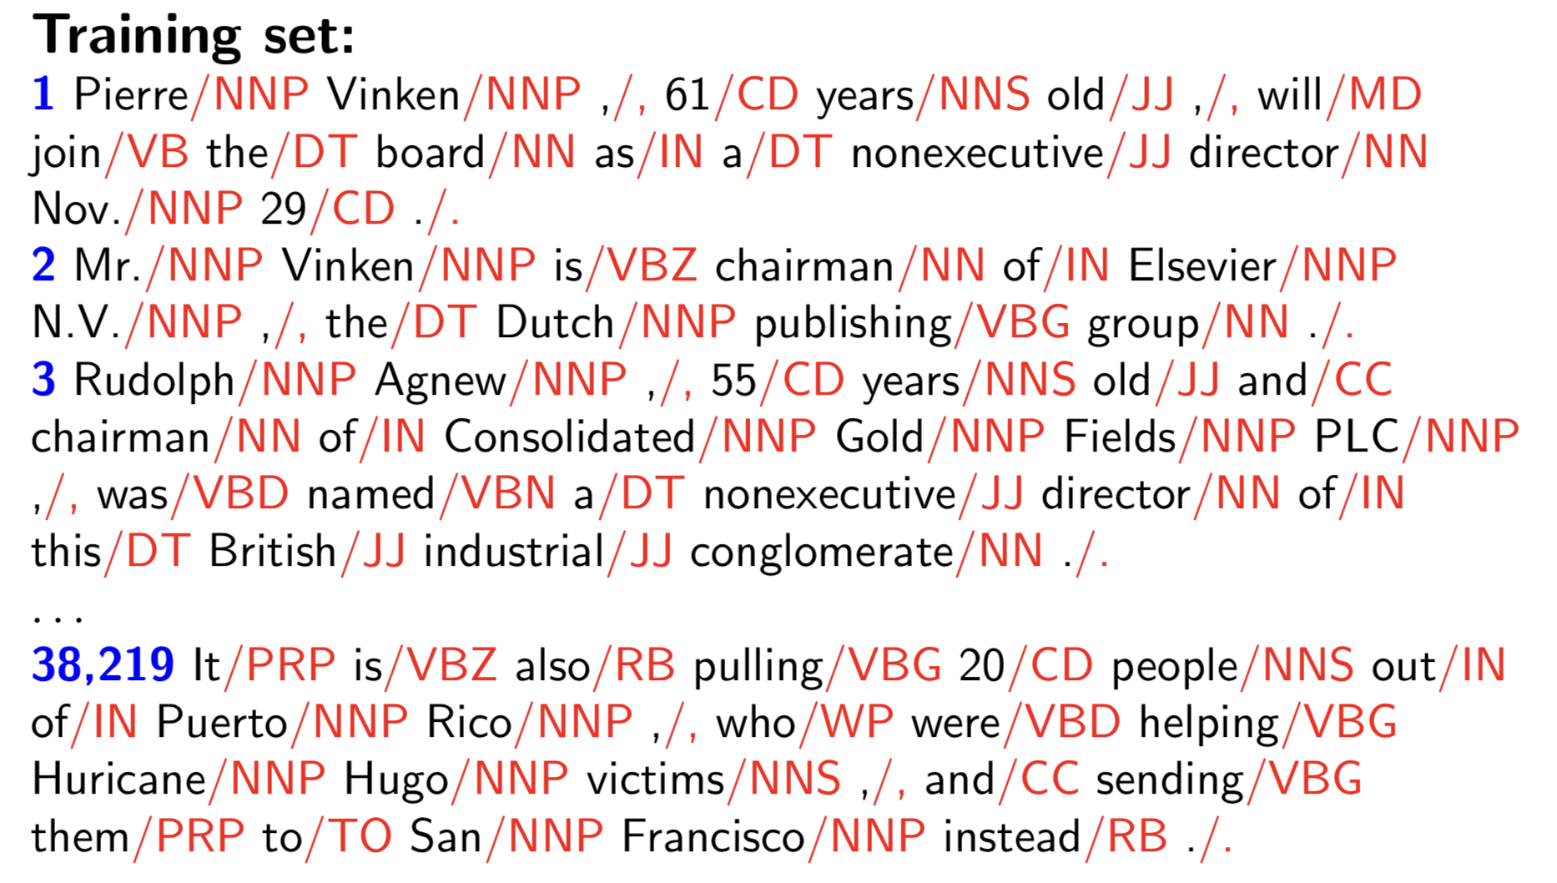
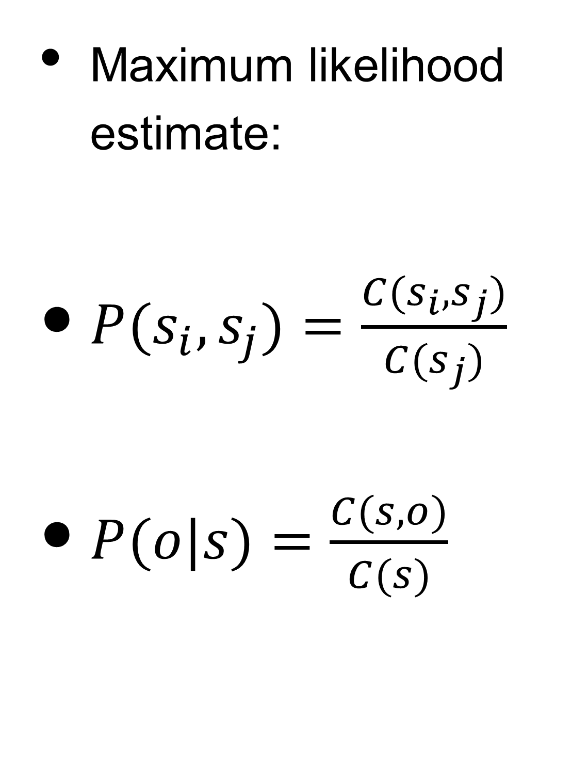
Learning from fully observed data
Fully labeled! All tags are known during training
Maximum likelihood estimate:
$P(s_{i},s_{j})=\frac{C(s_{i},s_{j})}{C(s_{j})}$
$P(o|s)=\frac{C(s,o)}{C(s)}$

Slide 28
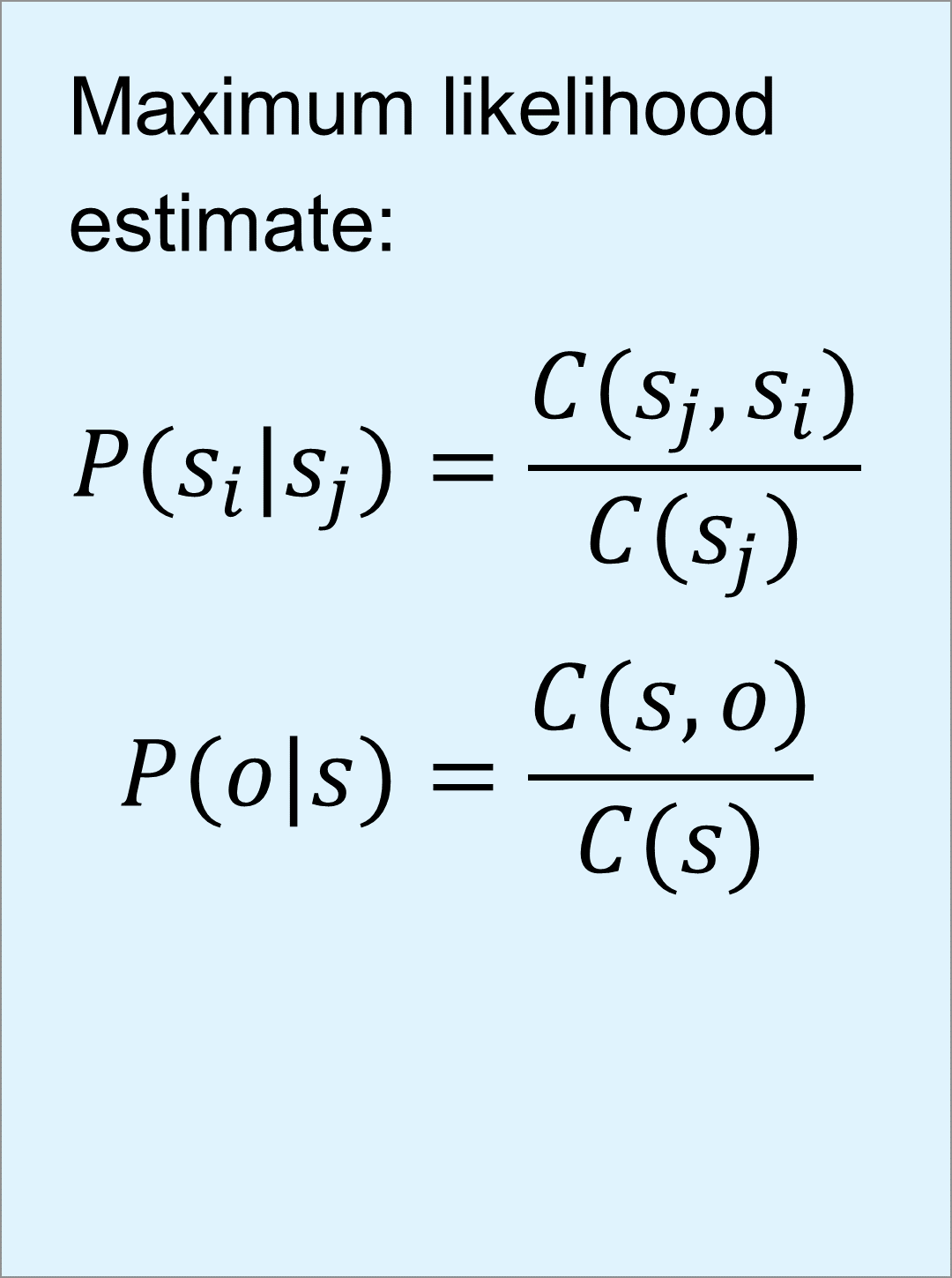
Learning from fully observed data
Easy!
Maximum likelihood estimate:
$$P(s_{i}|s_{j})=\frac{C(s_{j},s_{i})}{C(s_{j})}$$
$$P(o|s)=\frac{C(s,o)}{C(s)}$$

Slide 29

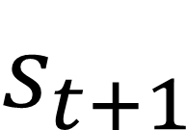
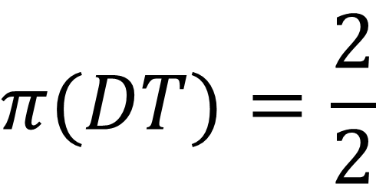

Estimating probabilities
$$π(DT)=\frac{2}{2}$$
$$s_{t+1}$$
$$o_{t}$$
 | DT | NN | IN | VBD
DT
NN
IN
VBD
 | the | cat | sat | on | mat | a | cleaned | chair | man
DT
NN
IN
VBD
$$s_{t}$$
a/DT man/NN cleaned/VBD the/DT mat/NN
the/DT cat/NN sat/VBD on/IN the/DT chair/NN
Training corpus:

Slide 30
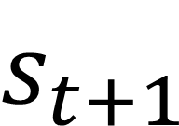
Estimating probabilities
$$π(DT)=\frac{2}{2}$$
$$s_{t+1}$$
$$o_{t}$$
 | DT | NN | IN | VBD
DT
NN
IN
VBD
 | the | cat | sat | on | mat | a | cleaned | chair | man
DT | 3/4 |  |  |  |  | 1/4
NN
IN
VBD
$$s_{t}$$
a/DT man/NN cleaned/VBD the/DT mat/NN
the/DT cat/NN sat/VBD on/IN the/DT chair/NN
Training corpus:

Slide 31
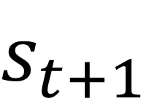
Estimating probabilities
$$π(DT)=\frac{2}{2}$$
$$s_{t+1}$$
$$o_{t}$$
 | DT | NN | IN | VBD
DT
NN
IN
VBD
 | the | cat | sat | on | mat | a | cleaned | chair | man
DT | 3/4 |  |  |  |  | 1/4
NN |  | 1/4 |  |  | 1/4 |  |  | 1/4 | 1/4
IN |  |  |  | 1/1
VBD |  |  | 1/2 |  |  |  | 1/2
$$s_{t}$$
a/DT man/NN cleaned/VBD the/DT mat/NN
the/DT cat/NN sat/VBD on/IN the/DT chair/NN
Training corpus:

Slide 32
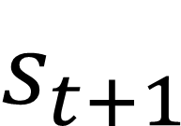
Estimating probabilities
$$π(DT)=\frac{2}{2}$$
$$s_{t+1}$$
$$o_{t}$$
 | DT | NN | IN | VBD
DT
NN
IN
VBD | 1/2 |  | 1/2
 | the | cat | sat | on | mat | a | cleaned | chair | man
DT | 3/4 |  |  |  |  | 1/4
NN |  | 1/4 |  |  | 1/4 |  |  | 1/4 | 1/4
IN |  |  |  | 1/1
VBD |  |  | 1/2 |  |  |  | 1/2
$$s_{t}$$
a/DT man/NN cleaned/VBD the/DT mat/NN
the/DT cat/NN sat/VBD on/IN the/DT chair/NN
Training corpus:

Slide 33
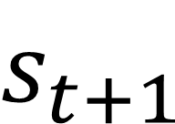
Estimating probabilities
$$π(DT)=\frac{2}{2}$$
$$s_{t+1}$$
$$o_{t}$$
 | DT | NN | IN | VBD | EOS
DT |  | 4/4
NN |  |  |  | 2/4 | 2/4
IN | 1/1
VBD | 1/2 |  | 1/2
 | the | cat | sat | on | mat | a | cleaned | chair | man
DT | 3/4 |  |  |  |  | 1/4
NN |  | 1/4 |  |  | 1/4 |  |  | 1/4 | 1/4
IN |  |  |  | 1/1
VBD |  |  | 1/2 |  |  |  | 1/2
$$s_{t}$$
a/DT man/NN cleaned/VBD the/DT mat/NN
the/DT cat/NN sat/VBD on/IN the/DT chair/NN
Training corpus:

Slide 34
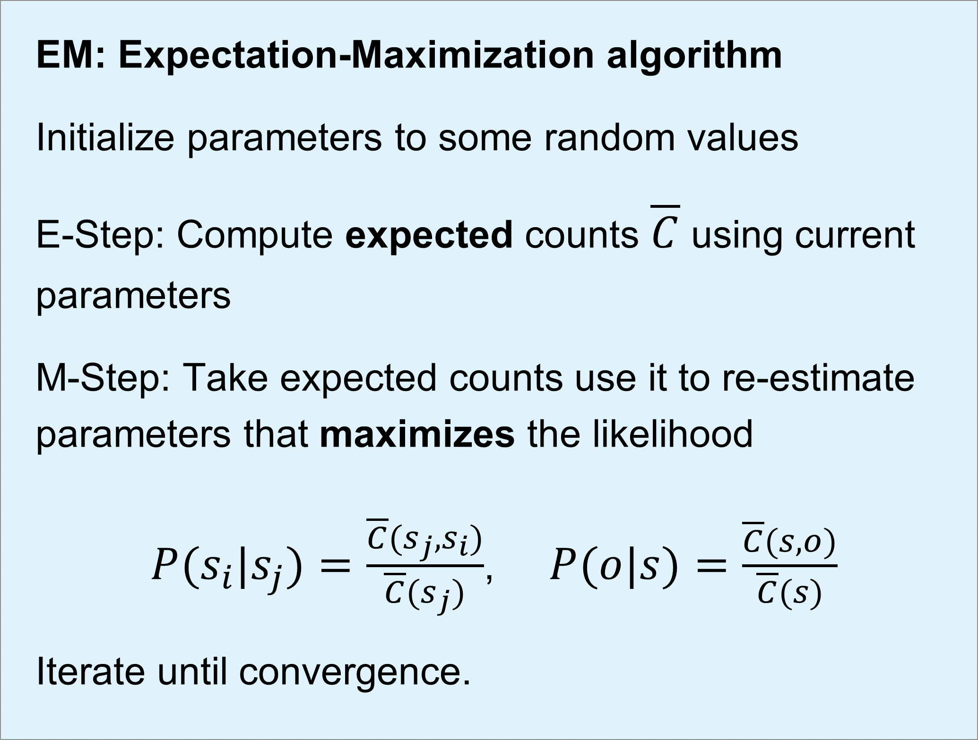
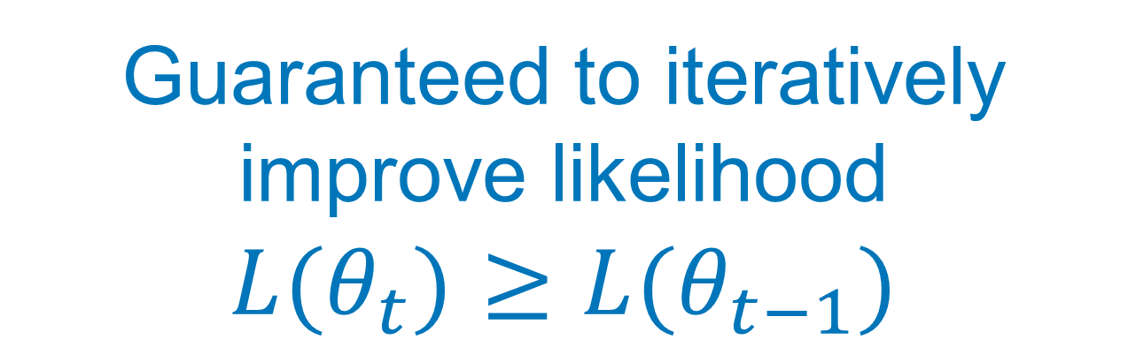
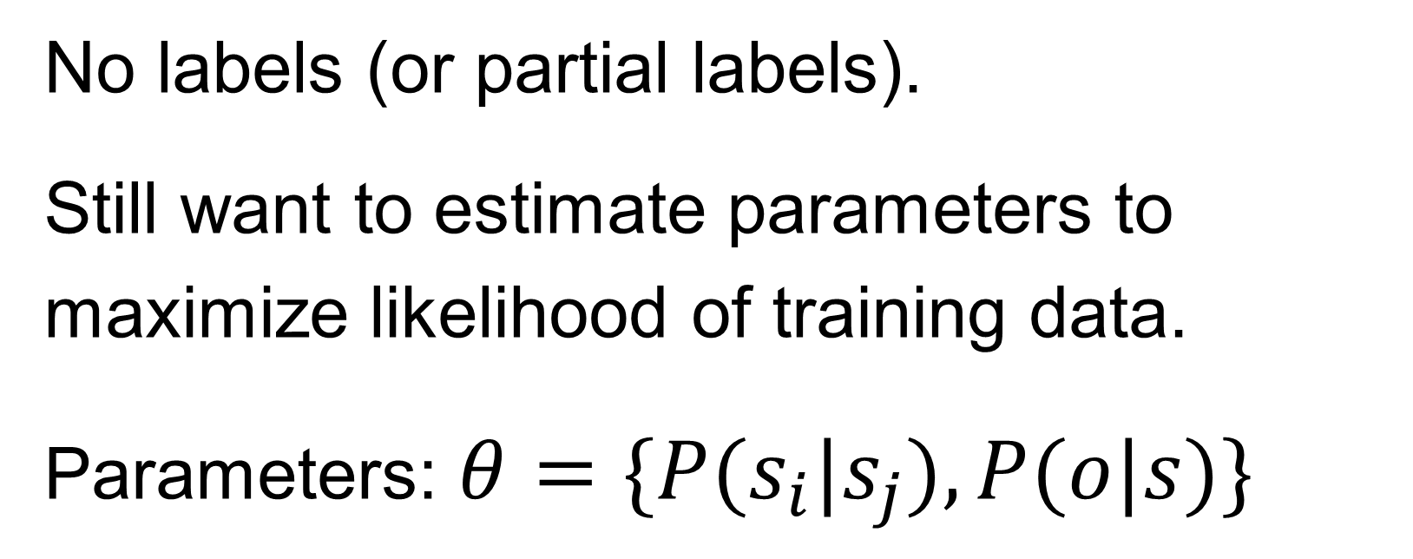
Learning from partially observable data
(unsupervised learning)
EM: Expectation-Maximization algorithm
Initialize parameters to some random values
E-Step: Compute expected counts $\overline{C}$ using current parameters
M-Step: Take expected counts use it to re-estimate parameters that maximizes the likelihood
$P(s_{i}|s_{j})=\frac{\overline{C}(s_{j},s_{i})}{\overline{C}(s_{j})}$, $P(o|s)=\frac{\overline{C}(s,o)}{\overline{C}(s)}$
Iterate until convergence.
No labels (or partial labels).
Still want to estimate parameters to maximize likelihood of training data.
Parameters: $θ=\{P(s_{i}|s_{j}),P(o|s)\}$
Guaranteed to iteratively improve likelihood
$$L(θ_{t})≥L(θ_{t−1})$$
EM for HMMs is also known as
Baum-Welch
Notes:
E-step of Baum-Welch has forward/backward inference passes so sometimes called forward-backward algorithm in NLP vs inside-outside algorithm (EM for trees).
Alternative is Viterbi training (in E-step, take just one path - the best scoring path)
Non-convex, initialization matters. Can get stuck on saddle points.
https://www.borealisai.com/en/blog/tutorial-19-parsing-iii-pcfgs-and-inside-outside-algorithm/
Viterbi EM (hard EM) vs soft EM (proper EM)

Slide 35
Decoding for HMMs
(finding the best sequence)

Slide 36
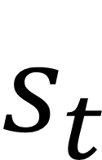
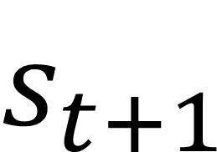
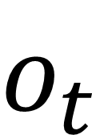
Example: POS tagging
the/?? cat/?? sat/?? on/?? the/?? mat/??
$$π(DT)=0.8$$
$$s_{t+1}$$
$$o_{t}$$
 | DT | NN | IN | VBD
DT | 0.05 | 0.8 | 0.05 | 0.1
NN | 0.05 | 0.2 | 0.15 | 0.6
IN | 0.5 | 0.2 | 0.05 | 0.25
VBD | 0.3 | 0.3 | 0.3 | 0.1
 | the | cat | sat | on | mat
DT | 0.5 | 0 | 0 | 0 | 0
NN | 0.01 | 0.2 | 0.01 | 0.01 | 0.2
IN | 0 | 0 | 0 | 0.4 | 0
VBD | 0 | 0.01 | 0.1 | 0.01 | 0.01
$$s_{t}$$
How to find best sequence?

Slide 37
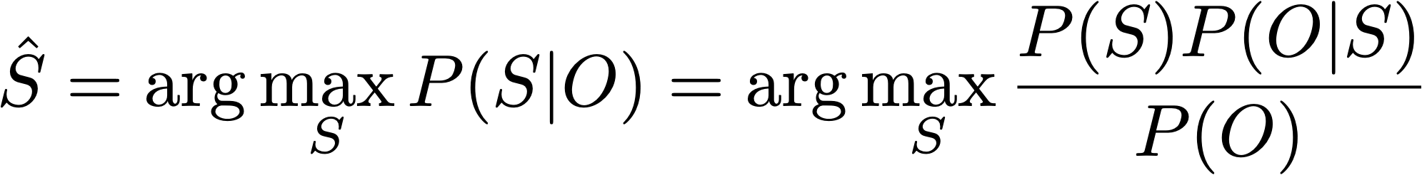
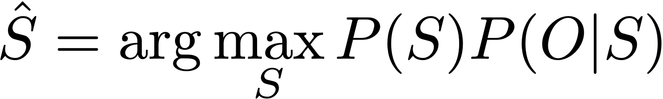
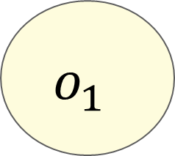
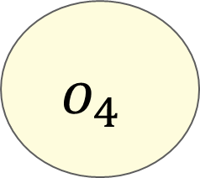
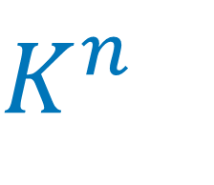
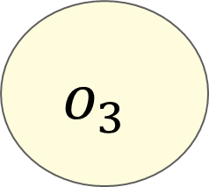
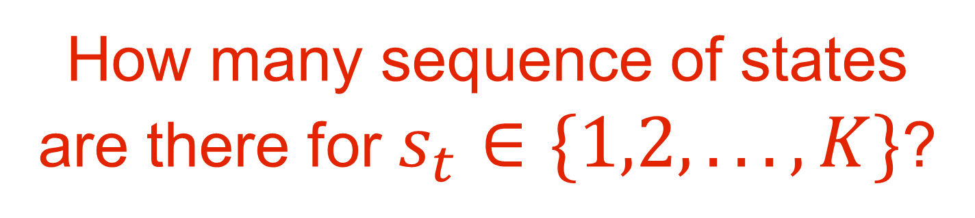


Decoding with HMMs
?
?
?
?
How many sequence of states
are there for $s_{t}∈\{1,2,...,K\}$?
$$o_{1}$$
$$o_{2}$$
$$o_{3}$$
$$o_{4}$$
$K^{n}$
Task: Find the most probable sequence of states $⟨s_{1},s_{2},...,s_{n}⟩$ given the observations $⟨o_{1},o_{2},...,o_{n}⟩$
What is the best sequence of tags for the observed sequence: the cat sat on the mat
Bayes Rule
Notes:
K^n

Slide 38







Decoding with HMMs
?
?
?
?
$$o_{1}$$
$$o_{2}$$
$$o_{3}$$
$$o_{4}$$
Task: Find the most probable sequence of states $⟨s_{1},s_{2},...,s_{n}⟩$ given the observations $⟨o_{1},o_{2},...,o_{n}⟩$
or
Emission
Probabilities
Transition
Probabilities

Slide 39


















Greedy decoding
$$s$$
 | DT | NN | IN | VBD
 | 0.8 | 0.1 | 0.05 | 0.05
$$π$$
$$s_{t+1}$$
DT
?
?
?
 | DT | NN | IN | VBD
DT | 0.05 | 0.8 | 0.05 | 0.1
NN | 0.05 | 0.2 | 0.15 | 0.6
IN | 0.5 | 0.2 | 0.05 | 0.25
VBD | 0.3 | 0.3 | 0.3 | 0.1
The
$$o_{2}$$
$$o_{3}$$
$$o_{4}$$
$$s_{t}$$
$$o_{t}$$
 | the | cat | sat | on | mat
DT | 0.5 | 0 | 0 | 0 | 0
NN | 0.01 | 0.2 | 0.01 | 0.01 | 0.2
IN | 0 | 0 | 0 | 0.4 | 0
VBD | 0 | 0.01 | 0.1 | 0.01 | 0.01
$$s_{t}$$
Emission
Probabilities
Transition
Probabilities

Slide 40






Greedy decoding
$$s$$
 | DT | NN | IN | VBD
 | 0.8 | 0.1 | 0.05 | 0.05
$$π$$
$$s_{t+1}$$
  DT
NN
?
?
 | DT | NN | IN | VBD
DT | 0.05 | 0.8 | 0.05 | 0.1
NN | 0.05 | 0.2 | 0.15 | 0.6
IN | 0.5 | 0.2 | 0.05 | 0.25
VBD | 0.3 | 0.3 | 0.3 | 0.1
The
cat
$$o_{3}$$
$$o_{4}$$
$$s_{t}$$
$$o_{t}$$
 | the | cat | sat | on | mat
DT | 0.5 | 0 | 0 | 0 | 0
NN | 0.01 | 0.2 | 0.01 | 0.01 | 0.2
IN | 0 | 0 | 0 | 0.4 | 0
VBD | 0 | 0.01 | 0.1 | 0.01 | 0.01
$$s_{t}$$
Emission
Probabilities
Transition
Probabilities

Slide 41


Greedy decoding
  DT
NN
VBD
IN
The
cat
sat
on
Not guaranteed to be optimal!
  Local decisions
Fast!
$$O(K×n)$$

Slide 42




Viterbi decoding
$$M[n,K]$$
$$n$$
 | the | cat | sat | on | the | mat
DT
NN
IN
VBD
Use dynamic programming!
Probability lattice, $M[n,K]$
  $n:\text{Number} \text{of} \text{time} \text{steps}$
  $K:\text{Number} \text{of} \text{states}$
$M[i,j]:$ Most probable sequence of states ending with state j at time i
$$K$$
Notes:
vih-TER-bee

Slide 43



Viterbi decoding
$$s$$
 | DT | NN | IN | VBD
 | 0.8 | 0.1 | 0.05 | 0.05
$$π$$
$$s_{t+1}$$
  DT
$$M[1,DT]=π(DT)P(\text{the}|DT)=0.8×0.5=0.4$$
 | DT | NN | IN | VBD
DT | 0.05 | 0.8 | 0.05 | 0.1
NN | 0.05 | 0.2 | 0.15 | 0.6
IN | 0.5 | 0.2 | 0.05 | 0.25
VBD | 0.3 | 0.3 | 0.3 | 0.1
NN
$$M[1,NN]=π(NN)P(\text{the}|NN)=0.1×0.01=0.001$$
$$s_{t}$$
IN
$$M[1,IN]=π(IN)P(\text{the}|IN)=0.05×0=0$$
$$o_{t}$$
VBD
 | the | cat | sat | on | mat
DT | 0.5 | 0 | 0 | 0 | 0
NN | 0.01 | 0.2 | 0.01 | 0.01 | 0.2
IN | 0 | 0 | 0 | 0.4 | 0
VBD | 0 | 0.01 | 0.1 | 0.01 | 0.01
$$M[1,VBD]=π(VBD)P(\text{the}|VBD)=0.05×0=0$$
$$s_{t}$$
the
Forward

Slide 44

$$M[n,K]$$
 | the | cat | sat | on | the | mat
DT | 0.4
NN | 0.001
IN | 0
VBD | 0

Slide 45





Viterbi decoding
$$s_{t+1}$$
  DT
  DT
 | DT | NN | IN | VBD
DT | 0.05 | 0.8 | 0.05 | 0.1
NN | 0.05 | 0.2 | 0.15 | 0.6
IN | 0.5 | 0.2 | 0.05 | 0.25
VBD | 0.3 | 0.3 | 0.3 | 0.1
$$M[2,DT]=\max_{k}M[1,k]P(DT|k)P(\text{cat}|DT)$$
$$=0$$
NN
NN
$$s_{t}$$
IN
IN
$$o_{t}$$
 | the | cat | sat | on | the | mat
DT | 0.4
NN | 0.001
IN | 0
VBD | 0
VBD
VBD
 | the | cat | sat | on | mat
DT | 0.5 | 0 | 0 | 0 | 0
NN | 0.01 | 0.2 | 0.01 | 0.01 | 0.2
IN | 0 | 0 | 0 | 0.4 | 0
VBD | 0 | 0.01 | 0.1 | 0.01 | 0.01
$$0$$
$$s_{t}$$
the
cat
Forward
$$M[1,K]$$
Notes:
vih-TER-bee

Slide 46









Viterbi decoding
$$s_{t+1}$$
  DT
  DT
 | DT | NN | IN | VBD
DT | 0.05 | 0.8 | 0.05 | 0.1
NN | 0.05 | 0.2 | 0.15 | 0.6
IN | 0.5 | 0.2 | 0.05 | 0.25
VBD | 0.3 | 0.3 | 0.3 | 0.1
NN
NN
$$s_{t}$$
$$M[2,NN]=\max_{k}M[1,k]P(NN|k)P(\text{cat}|NN)$$
$$=0.064$$
IN
IN
$$o_{t}$$
 | the | cat | sat | on | the | mat
DT | 0.4 | 0
NN | 0.001
IN | 0
VBD | 0
VBD
VBD
 | the | cat | sat | on | mat
DT | 0.5 | 0 | 0 | 0 | 0
NN | 0.01 | 0.2 | 0.01 | 0.01 | 0.2
IN | 0 | 0 | 0 | 0.4 | 0
VBD | 0 | 0.01 | 0.1 | 0.01 | 0.01
$$0.064$$
$$s_{t}$$
the
cat
Forward
$$M[1,K]$$

Slide 47





Viterbi decoding
$$s_{t+1}$$
  DT
  DT
 | DT | NN | IN | VBD
DT | 0.05 | 0.8 | 0.05 | 0.1
NN | 0.05 | 0.2 | 0.15 | 0.6
IN | 0.5 | 0.2 | 0.05 | 0.25
VBD | 0.3 | 0.3 | 0.3 | 0.1
NN
NN
$$s_{t}$$
IN
IN
$$M[2,IN]=\max_{k}M[1,k]P(IN|k)P(\text{cat}|IN)$$
$$=0$$
$$o_{t}$$
 | the | cat | sat | on | the | mat
DT | 0.4 | 0
NN | 0.001 | 0.064
IN | 0
VBD | 0
VBD
VBD
 | the | cat | sat | on | mat
DT | 0.5 | 0 | 0 | 0 | 0
NN | 0.01 | 0.2 | 0.01 | 0.01 | 0.2
IN | 0 | 0 | 0 | 0.4 | 0
VBD | 0 | 0.01 | 0.1 | 0.01 | 0.01
$$s_{t}$$
the
cat
$$0$$
Forward
$$M[1,K]$$

Slide 48





Viterbi decoding
$$s_{t+1}$$
  DT
  DT
 | the | cat | sat | on | the | mat
DT | 0.4 | 0
NN | 0.001 | 0.064
IN | 0 | 0
VBD | 0
 | DT | NN | IN | VBD
DT | 0.05 | 0.8 | 0.05 | 0.1
NN | 0.05 | 0.2 | 0.15 | 0.6
IN | 0.5 | 0.2 | 0.05 | 0.25
VBD | 0.3 | 0.3 | 0.3 | 0.1
NN
NN
$$s_{t}$$
IN
IN
$$0.0004$$
$$M[1,K]$$
$$o_{t}$$
VBD
VBD
 | the | cat | sat | on | mat
DT | 0.5 | 0 | 0 | 0 | 0
NN | 0.01 | 0.2 | 0.01 | 0.01 | 0.2
IN | 0 | 0 | 0 | 0.4 | 0
VBD | 0 | 0.01 | 0.1 | 0.01 | 0.01
$$M[2,VBD]=\max_{k}M[1,k]P(VBD|k)P(\text{cat}|VBD)$$
$$=0.0004$$
$$s_{t}$$
the
cat
Forward

Slide 49
Viterbi decoding
  DT
  DT
$$M[2,DT]=\max_{k}M[1,k]P(DT|k)P(\text{cat}|DT)=0$$
NN
NN
$$M[2,NN]=\max_{k}M[1,k]P(NN|k)P(\text{cat}|NN)=0.064$$
IN
IN
$$M[2,IN]=\max_{k}M[1,k]P(IN|k)P(\text{cat}|IN)=0$$
VBD
VBD
$$M[2,VBD]=\max_{k}M[1,k]P(VBD|k)P(\text{cat}|VBD)=0.004$$
the
cat
Forward

Slide 50
$$M[n,K]$$
 | the | cat | sat | on | the | mat
DT | 0.4 | 0
NN | 0.001 | 0.064
IN | 0 | 0
VBD | 0 | 0.004

Slide 51
Viterbi decoding
  DT
  DT
  DT
$$M[3,DT]=\max_{k}M[2,k]P(DT|k)P(\text{sat}|DT)=0$$
NN
NN
NN
$$M[3,NN]=\max_{k}M[2,k]P(NN|k)P(\text{sat}|NN)=0.000128$$
IN
IN
IN
$$M[3,IN]=\max_{k}M[2,k]P(IN|k)P(\text{sat}|IN)=0$$
VBD
VBD
VBD
$$M[3,VBD]=\max_{k}M[2,k]P(VBD|k)P(\text{sat}|VBD)=0.00384$$
the
cat
sat
Forward
Notes:
Viterbi/Greedy decoding gives the same thing….

Slide 52




$$M[n,K]$$
 | the | cat | sat | on | the | mat
DT | 0.4 | 0 | 0
NN | 0.001 | 0.064 | 0.000128
IN | 0 | 0 | 0
VBD | 0 | 0.008 | 0.00384

Slide 53













Viterbi decoding
  DT
  DT
  DT
  DT
NN
NN
NN
NN
IN
IN
IN
IN
VBD
VBD
VBD
VBD
The
cat
sat
on
$$M\left[i,j\right]=\max_{k}M\left[i−1,k\right]P\left(s_{j} | s_{k}\right)P\left(o_{i} | s_{j}\right), where 1≤k≤K,1≤i≤n$$
Backpointer
Backward:
$$\text{Pick}\max_{k}M[i,k]\text{and} \text{backtrack}$$

Slide 54











Viterbi decoding
  DT
  DT
  DT
  DT
NN
NN
NN
NN
IN
IN
IN
IN
Time complexity?
VBD
VBD
VBD
VBD
O(K x K x n )
The
cat
sat
on
$$M\left[i,j\right]=\max_{k}M\left[i−1,k\right]P\left(s_{j} | s_{k}\right)P\left(o_{i} | s_{j}\right), where 1≤k≤K,1≤i≤n$$
Backward:
$$\text{Pick}\max_{k}M[i,k]\text{and} \text{backtrack}$$
Notes:
O (T x S x S)
Similar to the iterative algorithm you implemented for HW1 (dynamic programming)
max-sum algorithm

Slide 55
Beam Search
If K (number of states) is too large, Viterbi is too expensive!
  DT
  DT
  DT
  DT
NN
NN
NN
NN
IN
IN
IN
IN
VBD
VBD
VBD
VBD
The
cat
sat
on

Slide 56
Beam Search
If K (number of states) is too large, Viterbi is too expensive!
  DT
  DT
  DT
  DT
NN
NN
NN
NN
VBD
VBD
VBD
VBD
IN
IN
IN
IN
The
cat
sat
on
Many paths have very low likelihood!

Slide 57

Beam Search
If K (number of states) is too large, Viterbi is too expensive!
Keep a fixed number of hypotheses at each point
  Beam width, $β$
Notes:
/wɪdθ/

Slide 58





Beam Search
Keep a fixed number of hypotheses at each point
  DT
$$score=−4.1$$
NN
$$score=−9.8$$
$$β=2$$
VBD
$$score=−6.7$$
IN
$$score=−10.1$$
The

Slide 59




Beam Search
Keep a fixed number of hypotheses at each point
  DT
  DT
$score=−16.5$ (the max among the two paths)
NN
NN
$$score=−6.5$$
$$β=2$$
VBD
VBD
$$score=−13.0$$
IN
IN
$$score=−22.1$$
The
cat
Step 1: Expand all partial sequences in current beam

Slide 60


Beam Search
Keep a fixed number of hypotheses at each point
  DT
  DT
$$score=−16.5$$
NN
NN
$$score=−6.5 (from the DT branch)$$
$$β=2$$
VBD
VBD
$score=−13.0$ $(from the DT branch)$
IN
IN
$$score=−22.1$$
The
cat
Step 2: Prune set back to top $β$ sequences

Slide 61







Beam Search
Keep a fixed number of hypotheses at each point
  DT
  DT
  DT
  DT
NN
NN
NN
NN
$$β=2$$
VBD
VBD
VBD
VBD
IN
IN
IN
IN
The
cat
sat
on
$$\text{Pick}\max_{k}M[n,k]\text{from} \text{within} \text{beam} \text{and} \text{backtrack}$$

Slide 62


Beam Search
If K (number of states) is too large, Viterbi is too expensive!
Keep a fixed number of hypotheses at each point
  Beam width, $β$
Trade-off computation for (some) accuracy
Time complexity?
$$β×K×T$$

Slide 63
Beyond Bigram HMMs

Slide 64







Beyond bigrams
Real-world HMM taggers have more relaxed assumptions
Trigram HMM: $P(s_{t+1}|s_{1},s_{2},...,s_{t})≈P(s_{t+1}|s_{t−1},s_{t})$
  DT
NN
VBD
IN
The
cat
sat
on
Pros?
Cons?

Slide 65

HMMs for language modeling
Language modeling: estimate probability of sentence
P(the, cat, sat, on, the, mat) = ??
Need to sum over the probabilities of the possible states
Use Viterbi-like algorithm, but take sum instead of max!
  Known as the “Forward” algorithm
Notes:
Forward algorithm

Slide 66



Slide 67












Generative vs Discriminative
HMM is a generative model
Can we model $P(s_{1},...,s_{n}|o_{1},...,o_{n})$ directly?
Discriminative
Recall L2 P17
Generative
Logistic Regression: $P(c|d)$
Naive Bayes: $P(c)P(d|c)$
MEMM (Maximum Entropy Markov Model): $P(s_{1},...,s_{n}|o_{1},...,o_{n})$
No factorization
HMM: $P(s_{1},...,s_{n})P(o_{1},...,o_{n}|s_{1},...,s_{n})$

Slide 68










MEMM (Maximum Entropy Markov Model)
  DT
NN
VBD
IN
  DT
NN
VBD
IN
The
cat
sat
on
The
cat
sat
on
HMM
MEMM
No factorization
Into emission and transition probabilities
Compute the posterior directly:
  $$\overset{̂}{y}=arg\max_{y}P(y|X)=arg\max_{S}\underset{i}{∏}P(s_{i}|o_{i},s_{i−1})$$
Use features:
random variable
Notes:
The left is proportional to the right

Slide 69

















Conditional Random Field (advanced)
undirected
$$s_{1}$$
$$s_{2}$$
$$s_{3}$$
$$s_{4}$$
$$o_{1}$$
$$o_{2}$$
$$o_{3}$$
$$o_{4}$$
When a relationship is log-linear, an additive change in the features
produces a multiplicative (exponential) change in the output.
Compute log-linear functions over cliques
Less independence assumptions
Ex: $P(s_{t}|\text{everything} \text{else})∝exp(w⋅f(s_{t−1},s_{t},s_{t+1},O))$

Slide 70





Conditional Random Field (advanced)
$$s_{1}$$
$$s_{2}$$
$$s_{3}$$
$$s_{4}$$
$$o_{1}$$
$$o_{2}$$
$$o_{3}$$
$$o_{4}$$
Global vs Local normalization
Define feature functions $f$
Compute score $w⋅f(s_{t−1},s_{t},s_{t+1},O)$
Normalize $P(s_{t}|O)=\frac{exp(w⋅f(s_{t−1},s_{t},s_{t+1},O))}{∑_{s}exp(w⋅f(s_{t−1},s_{t},s_{t+1},O))}$
Global normalization
can be expensive
Notes:
Hidden state need to be summed over
Normalization can be local (over single state) or global (over sequence of states)

Slide 71
Conditional Random Field (advanced)
$$s_{1}$$
$$s_{2}$$
$$s_{3}$$
$$s_{4}$$
$$o_{1}$$
$$o_{2}$$
$$o_{3}$$
$$o_{4}$$
Decoding: Best sequence can be found using the Viterbi algorithm
Training: Find parameters using variant of Forward algorithm (or SGD)
Can be used on top of other model (e.g., NN) outputs to refine output for consistency
Notes:
Hidden state need to be summed over
Best sequence can be found using the Viterbi algorithm
Find parameters using variant of Forward algorithm (or SGD)
Can be used with neural networks to refine / post process output for consistency

Slide 72
Summary
Sequence modeling - POS tagging, Named Entity Recognition
Hidden Markov Models (HMM)
  Generative model
  Markov assumption: assume current state only depend on last few states
  Labels are considered “hidden states”
  Training
    If training data includes labels, MLE is simple
    More generally (partially observed/no labels), use Expectation-Maximation (EM)
  Decoding
    Greedy, Viterbi (exact), Beam search
CRFs - Discriminative, log-linear models for sequence modelling

